Slide 1
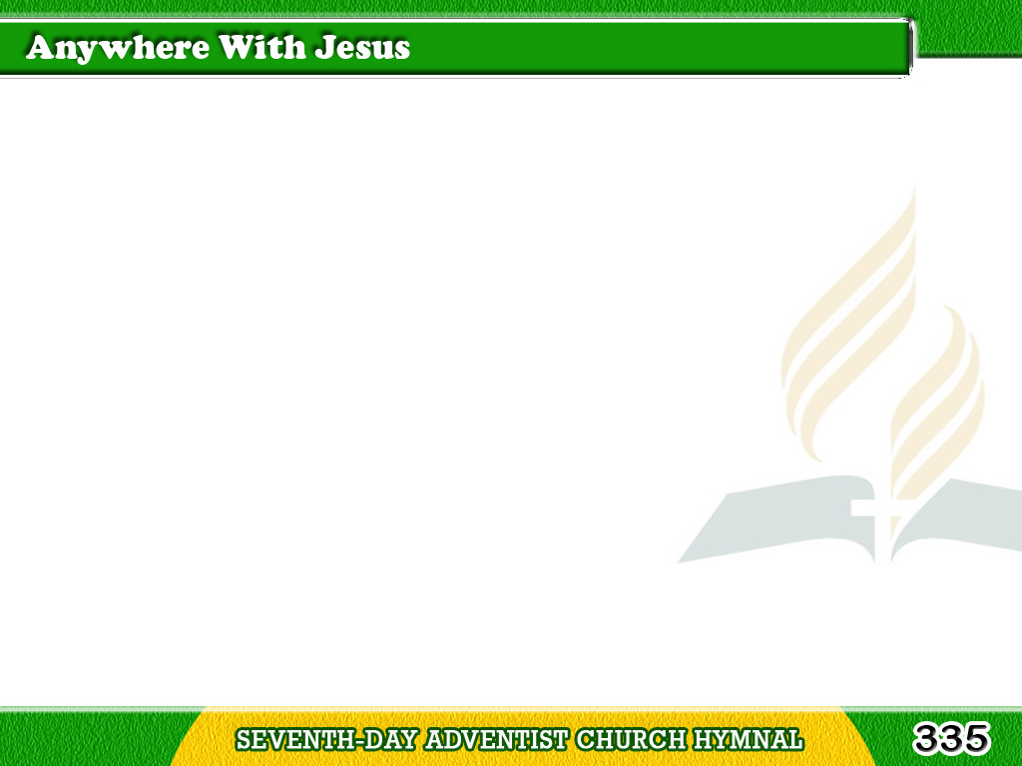

1/3
Anywhere with Jesus
I can safely go,
Anywhere He leads me
in this world below;
Tagalog
Version

Slide 2
1/3
Anywhere without Him,
dearest joys would fade;
Anywhere with Jesus
I am not afraid
Tagalog
Version

Slide 3
1/3
Chorus
Anywhere! anywhere!
Fear I cannot know;
Anywhere with Jesus
I can safely go.
Tagalog
Version

Slide 4
2/3
Anywhere with Jesus
I am not alone;
Other friends may fail me,
He is still my own;
Tagalog
Version

Slide 5
2/3
Though His hand may lead me
over dreary ways,
Anywhere with Jesus
is a house of praise.
Tagalog
Version

Slide 6
2/3
Chorus
Anywhere! anywhere!
Fear I cannot know;
Anywhere with Jesus
I can safely go.
Tagalog
Version

Slide 7
3/3
Anywhere with Jesus
I can go to sleep,
When the gloomy shadows
round about me creep,
Tagalog
Version

Slide 8
3/3
Knowing I shall waken
nevermore to roam;
Anywhere with Jesus
will be home sweet home.
Tagalog
Version

Slide 9
3/3
Chorus
Anywhere! anywhere!
Fear I cannot know;
Anywhere with Jesus
I can safely go.
Tagalog
Version

